Slide 1



Computer Networks
Prepared & Presented by: Mirlan Nurbekov, Lecturer
Office hours: Friday 9:00–17:00
AlaToo IT & Business College
Fall 2025

Slide 2
Course Introduction
This course provides a foundational understanding of the principles, technologies, and protocols that govern computer networks. We will explore how data travels across the globe, from the basic physical hardware to the complex logical systems that enable communication. The curriculum will adopt a layered approach, starting with a high-level overview before diving into the specific functions of each network layer. By the end of this course, students will be able to describe network architectures, analyze data flow, and troubleshoot common networking issues.

Slide 3
Grading & Assessment
Midterm test: a comprehensive assessment of materials from week 1 till week 8 (100 points)
Final exam (100 points)

Slide 4
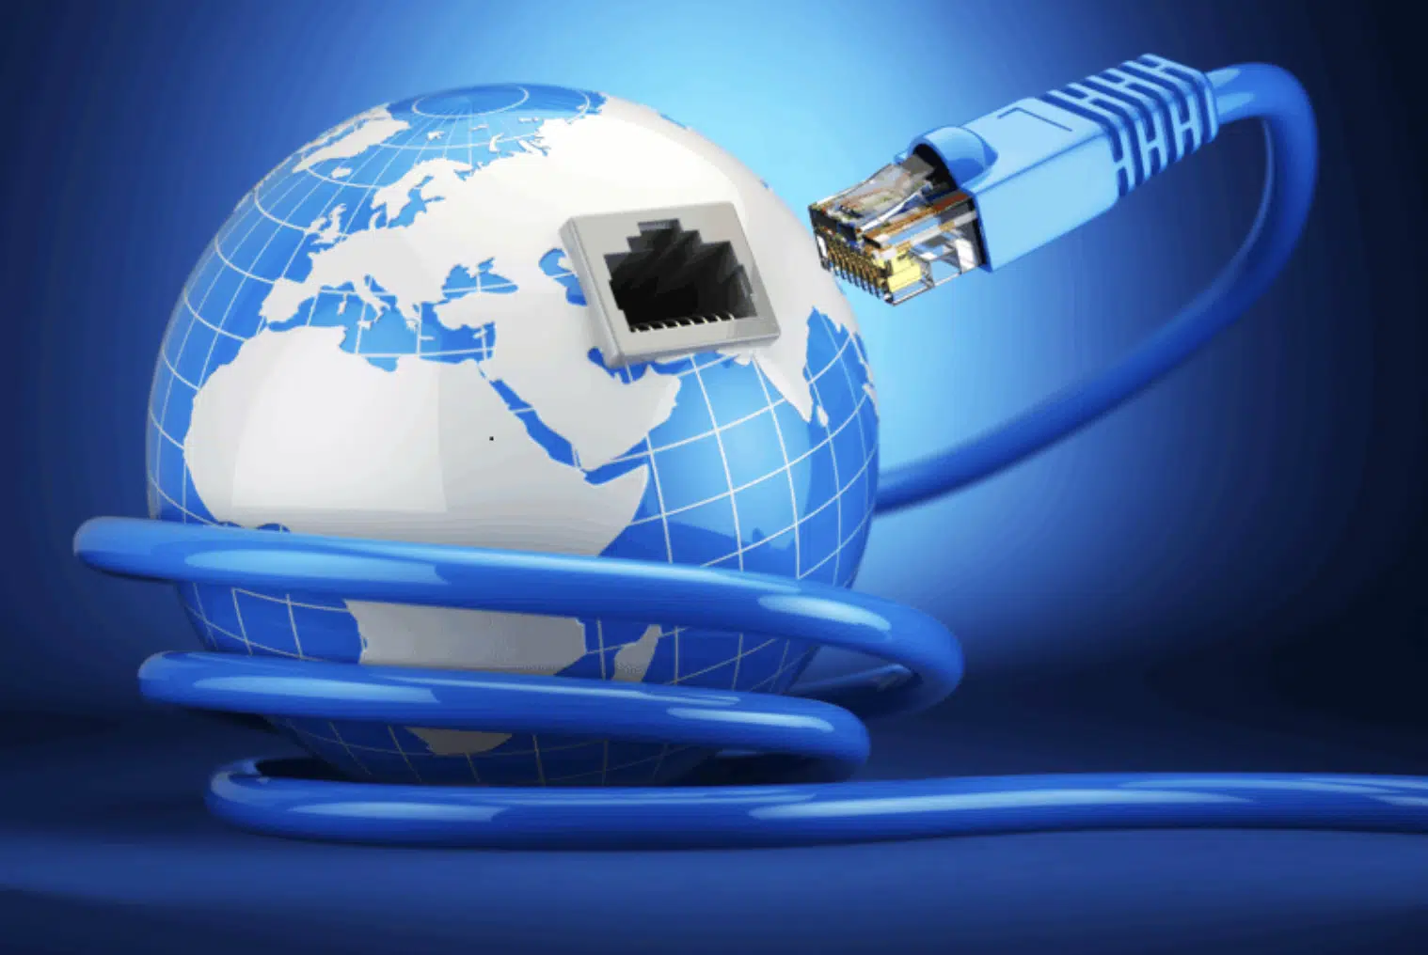
What is the Internet?

Slide 5

The Internet is the network of networks…
The Internet is a global network that connects millions of computers and devices around the world. It allows people to share information, communicate, and access resources anytime, anywhere. Devices on the Internet communicate using a set of rules called protocols (for example, TCP/IP).

Slide 6
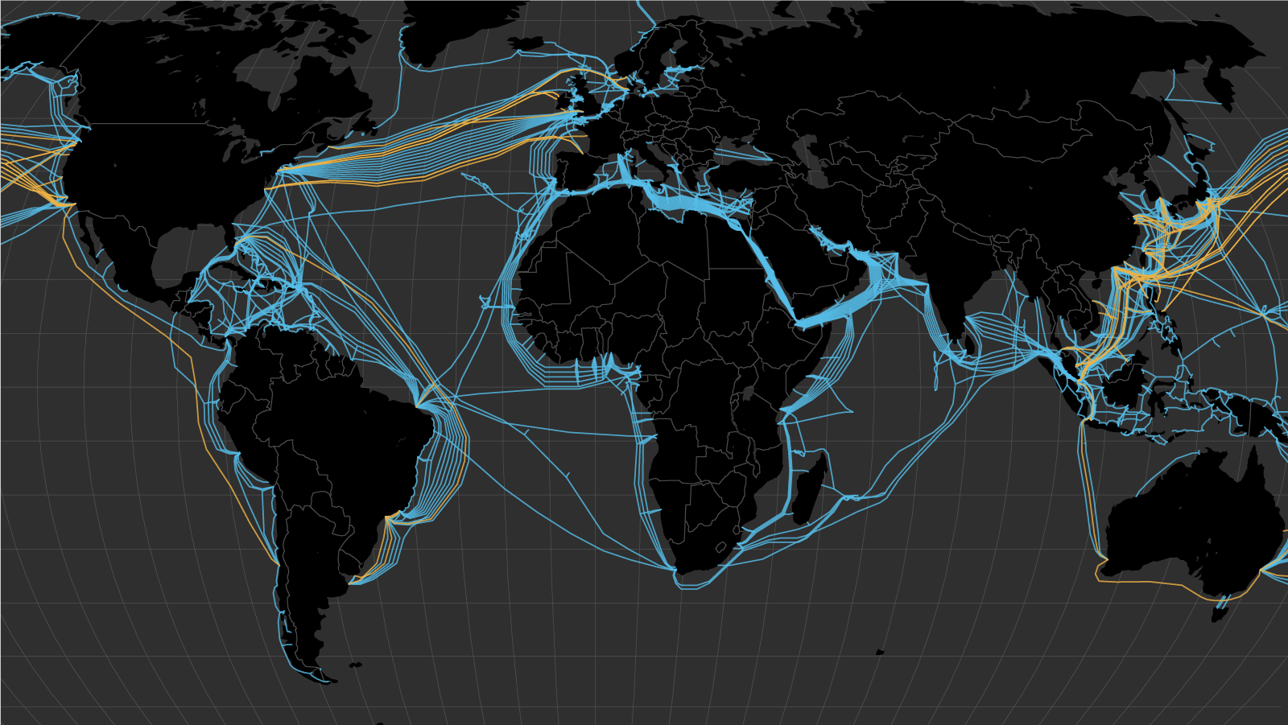
The Internet is the network of networks…

Slide 7
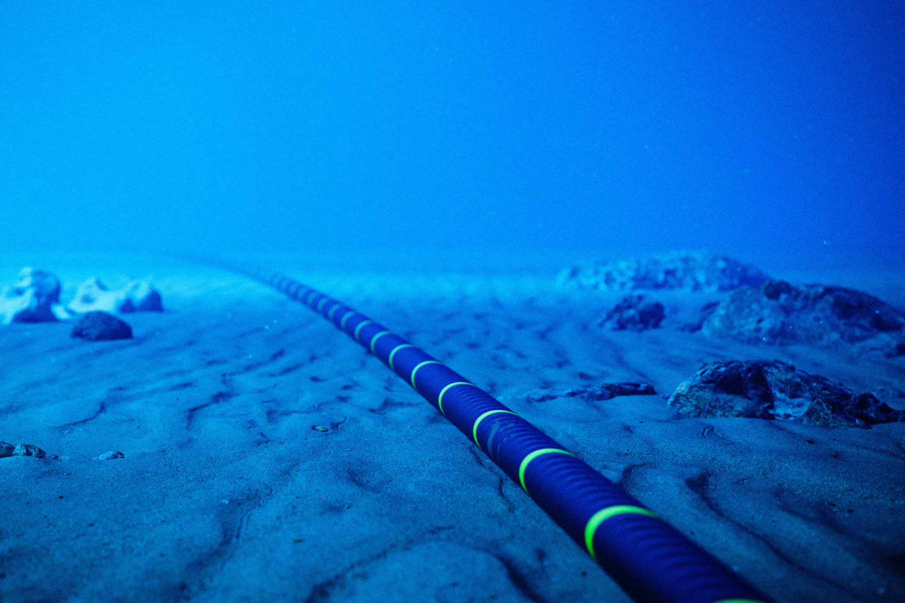
The Internet is the network of networks…

Slide 8
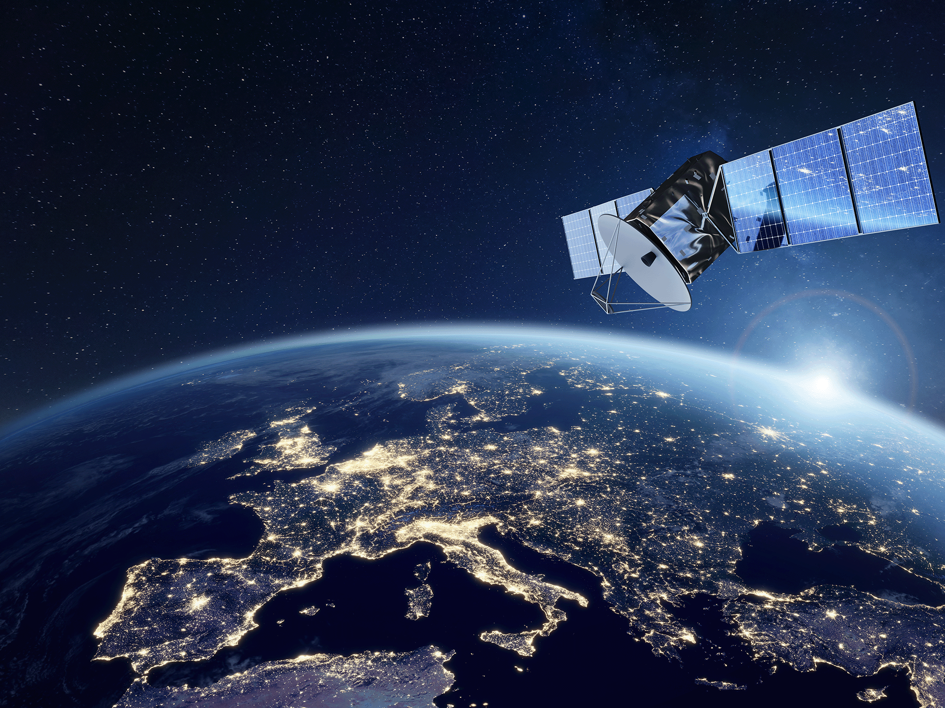
The Internet is the network of networks…

Slide 9
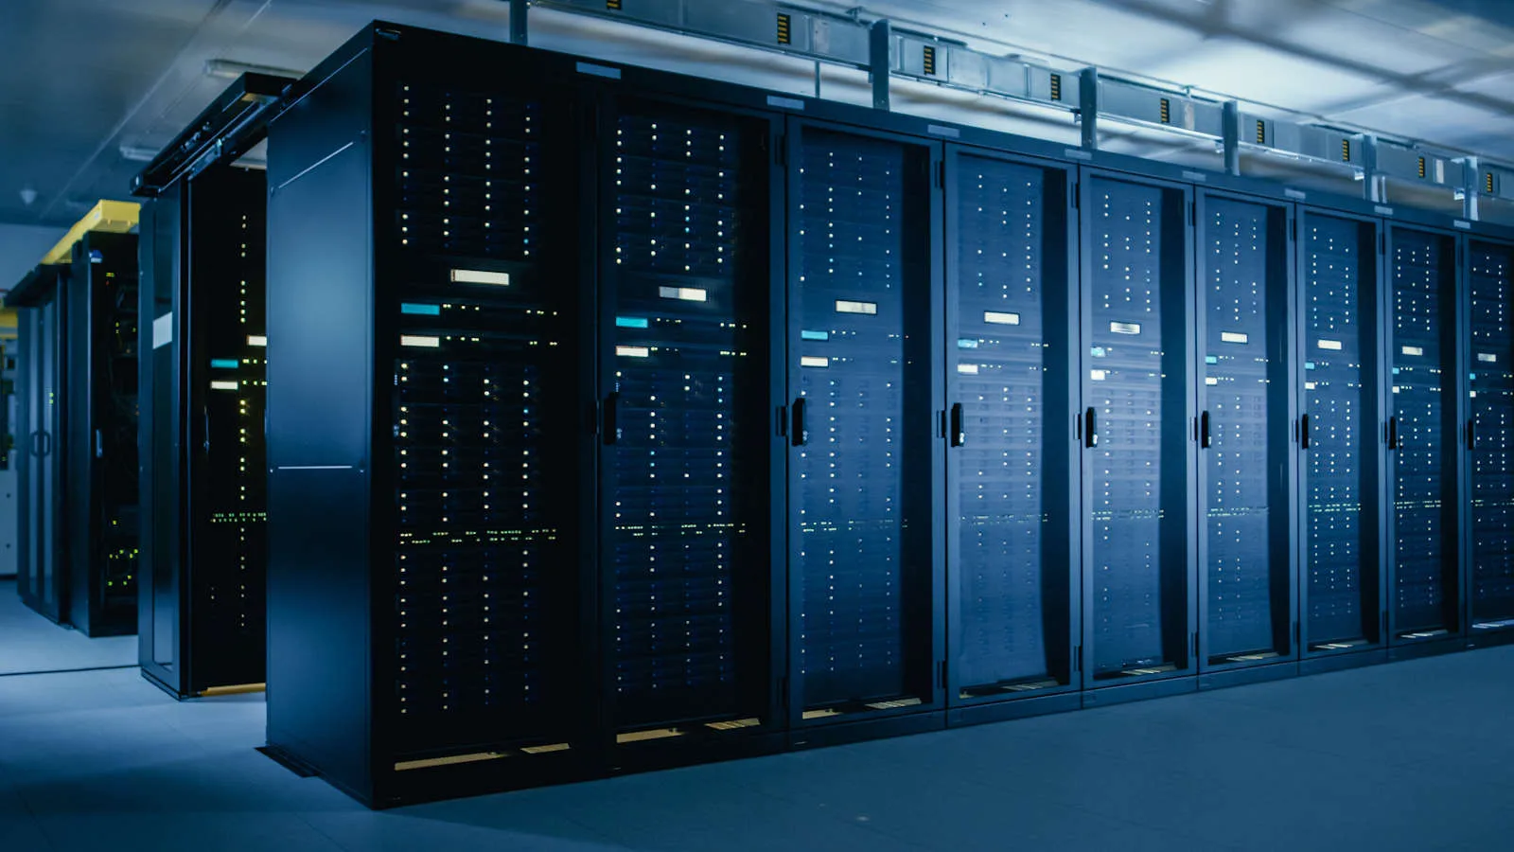
The Internet is the network of networks…

Slide 10
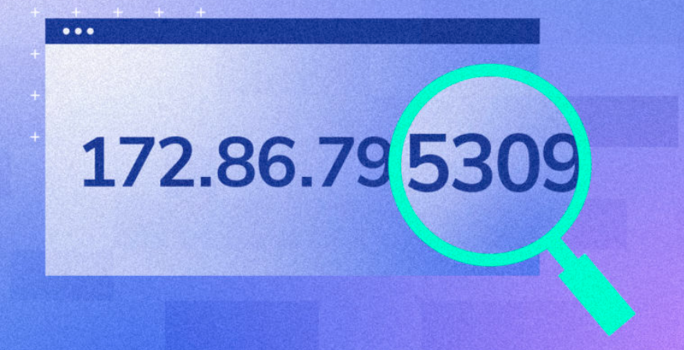
What is an IP Address?
IP stands for Internet Protocol. An IP address is a unique number that identifies every device connected to a network (like your phone, computer, or router). It works like a home address — it tells data where to go and where it came from. Without IP addresses, devices wouldn’t know how to communicate over the Internet.

Slide 11
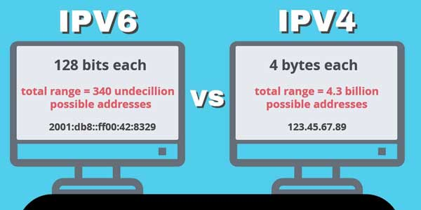
IP versions

Slide 12
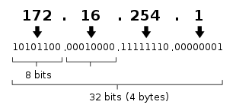
IPv4
(Internet Protocol version 4)
IPv4 contains 4 sections called octet and it is 32 bits in size. This means that each octet is 8 bit in size. There are 4,294,967,296 IPv4 in total.

Slide 13
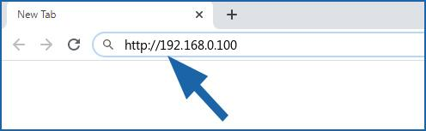
IPv4
(Structure)
IPv4 addresses consist of 4 octets (8 bits each).
Each octet can range from 0 to 255.
Written in dotted decimal format: A.B.C.D
Example: 192.168.0.100

Slide 14

Types of IPv4 addresses
Public IP – globally unique, accessible on the Internet.
Private IP – used inside local networks, not routable on the Internet.
Static IP – manually assigned, doesn’t change.
Dynamic IP – assigned automatically by DHCP, can change over time.

Slide 15
Public IP
An IP address that is visible on the Internet and unique worldwide. It enables devices to communicate across different networks globally. It can be any IPv4 address outside private ranges. Public IPs can be static or dynamic.
Example: 142.250.72.206 (a Google server)
Real-world scenario:
Your home router is assigned a public IP by your ISP.
Websites and online services can send data back to your router using this address. Accessing www.google.com from your laptop uses your public IP.

Slide 16
Private IP
It is used inside Local Networks, NOT routable on the Internet. An IP address used within a local network. Not directly reachable from the Internet. It allows devices in a home, office, or organization to communicate internally. To access the Internet, private IPs are translated to a public IP using NAT (Network Address Translation).
Private Ranges (IPv4):
10.0.0.0 – 10.255.255.255
172.16.0.0 – 172.31.255.255
192.168.0.0 – 192.168.255.255
Example: 192.168.1.10 (your laptop at home)
Real-world scenario:
All devices in your home network—laptops, phones, smart TVs—get private IPs.They can share files, print documents to the same printer, and play local multiplayer games.

Slide 17
Static IP
This IP is manually assigned, it doesn’t change. (a fixed IP address manually assigned to a device.) It ensures the device always uses the same address for reliable access. Static IPs avoid conflicts in networks with multiple devices and simplify network management.
Example: 192.168.1.100 (office network printer)
Real-world scenario:
Servers, CCTV cameras, and printers often use static IPs so users can always connect to the same address.
Remote work setups or hosting a website at home also benefit from static public IPs.

Slide 18
Dynamic IP
It is assigned automatically by DHCP(Dynamic Host Configuration Protocol)It can change over time. They are common for home Internet connections, while dynamic private IPs are standard in almost all networks. It simplifies network management, avoids manual configuration, and efficiently uses IP address pools.
It is useful for mobile devices or networks with many transient users.
Example: Your smartphone gets 192.168.1.25 today, 192.168.1.26 tomorrow.
Real-world scenario:
Most home networks and many ISPs use dynamic IPs for devices.
Every time your device reconnects, it may get a different IP.

Slide 19
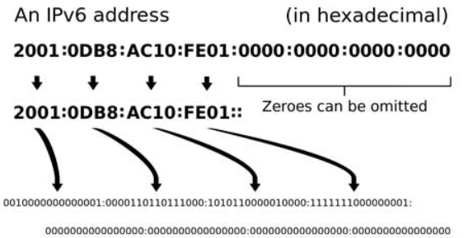
IPv6
(Internet Protocol version 6)
The newer version designed to replace IPv4. IPv6 provides a much larger number of IP addresses and improved efficiency. It uses 128 bits instead of 32 bits (IPv4), allowing trillions of unique addresses. It also offers better security and faster routing.

Slide 20
Why IPv6?
What happened to IPv5?
There is no official IPv5 for general Internet use.
IPv5 was an experimental protocol called Internet Stream Protocol (ST or ST-II).
It was designed in the late 1970s–1980s for streaming voice and video over networks.
IPv5 never replaced IPv4 because it was experimental and limited in scope. IPv5 did not solve IPv4’s address shortage problem. IPv4 has limited addresses (~4.3 billion).

Slide 21
IPv6
(Address structure)
IPv6 addresses are 128 bits long, written in 8 groups of 4 hexadecimal digits.
Format: 2001:0db8:85a3:0000:0000:8a2e:0370:7334
Leading zeros in a group can be omitted, and consecutive zeros can be replaced with :: once.
Example: 2001:db8:85a3::8a2e:370:7334

Slide 22
IPv6
(Types of addresses)
Global Unicast: publicly routable addresses, similar to IPv4 public IPs.
Example: 2001:0db8:1234::1
Link-Local: automatically assigned, only valid on the local network segment.
Always starts with FE80::/10
Multicast: sent to multiple devices simultaneously.
Anycast: Sent to the nearest device in a group.
Unique Local Addresses (ULA): Private addresses, similar to IPv4 private IPs.

Slide 23
Advantages of IPv6 over IPv4
Huge address space: 128-bit vs 32-bit.
No need for NAT; devices can have unique public addresses.
Simplified packet header → faster routing.
Built-in security with IPsec.
Auto-configuration: devices can generate their own addresses.
Better support for mobile devices and IoT.

